Slide 1
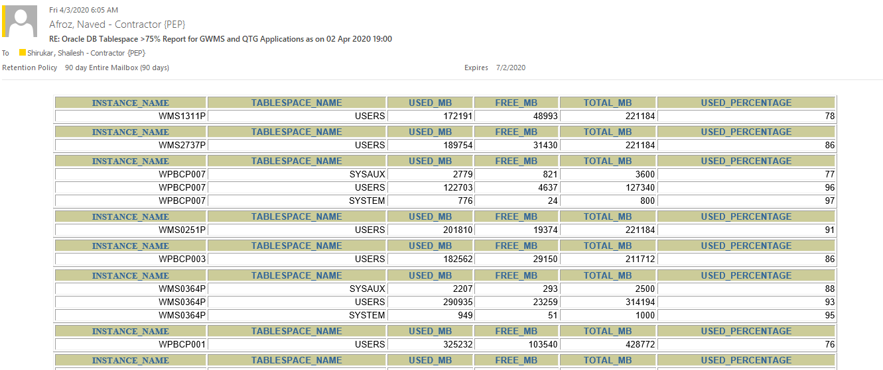
DB List
Format Style
SQL Extract
Email List
Central Server
DB1
DB2
DB3
DB4
DB5
DBn

